Slide 1
Variables and Surfing
OCE2901 – Surf Engineering Analysis

Slide 2

Introduction What are we doing?
Check out this YouTube video: https://youtu.be/vUt8fWLqXGg?t=1178
19:38 – 23:10

Slide 3
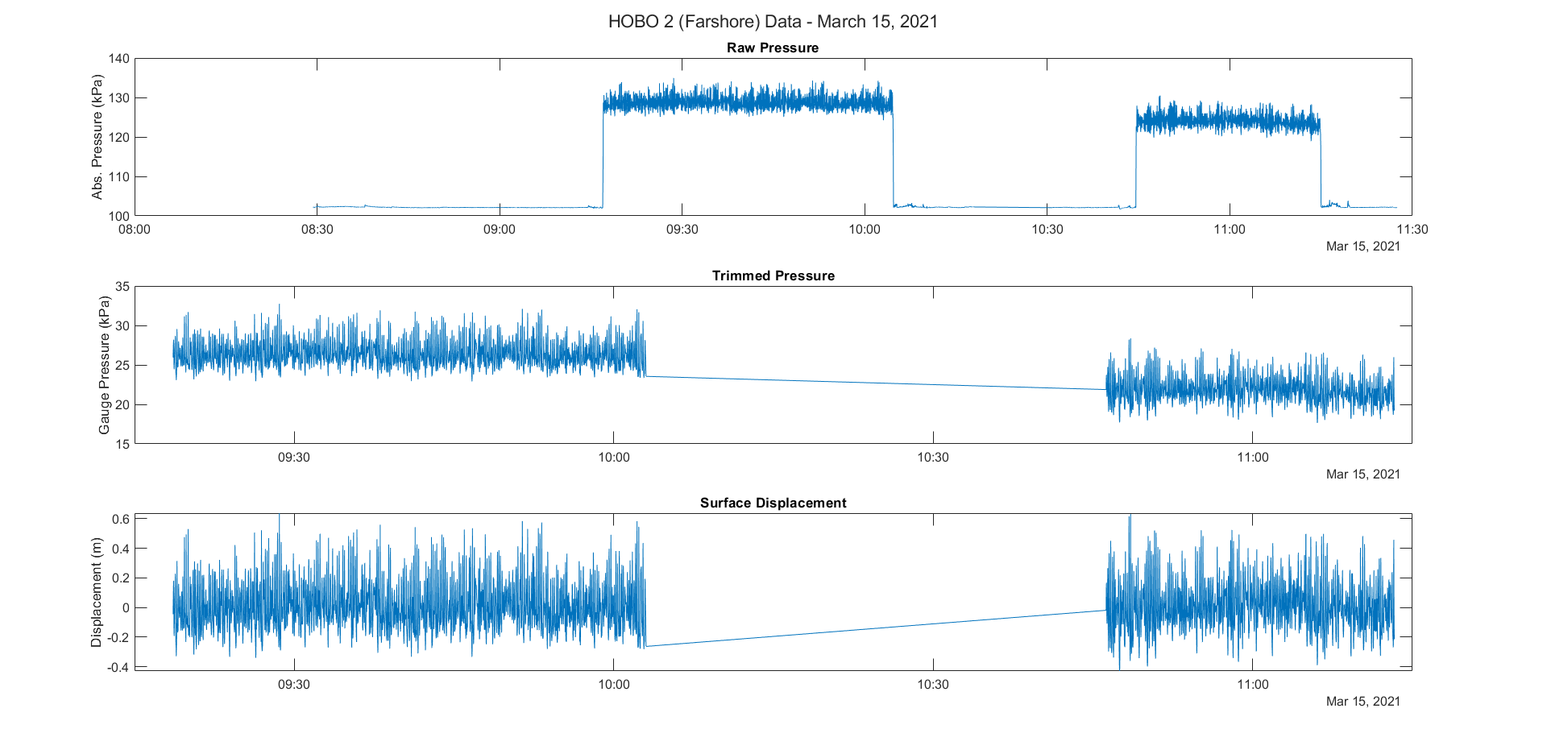
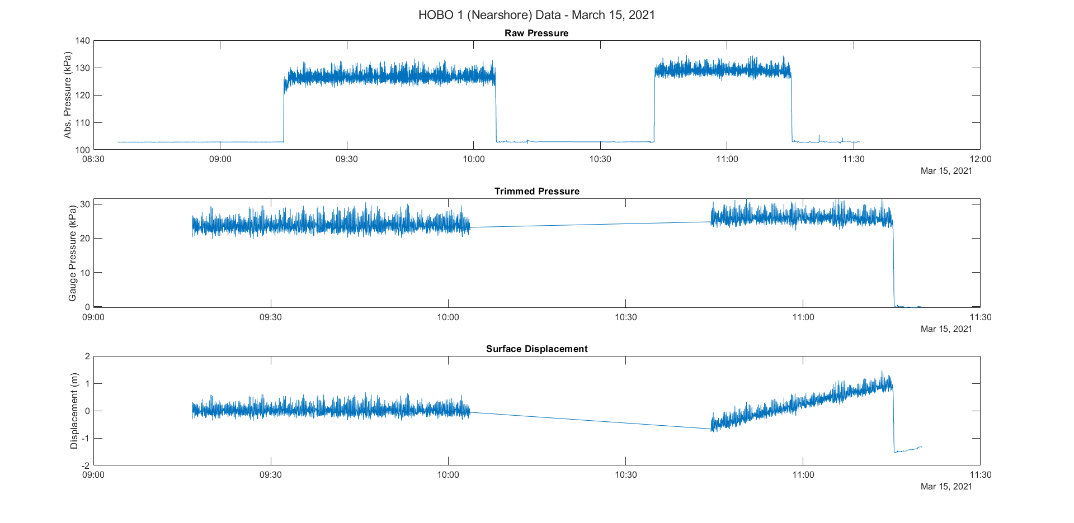
What is Data Analysis?
Process of processing and looking at data to discern relationships present in the data
For this course, we will be looking at how surfers interact with coastal waves
Data must be reliable and pertinent to the question the researcher is seeking to answer!

Slide 4
Types and Classes of Variables
Nominal variable: has categories, but no ranking order
Animal
Vegetable
Minerals
Ordinal variable: ordered, but no quantitative difference
Red is A
Blue is B
Green is C
Interval Variable: numerical units, non-zero
IQ, no real ratio value
Ratio variable: true units, includes zero
Acceleration
Velocity
Displacement
Exercise: Give some other examples of each type of variable

Slide 5
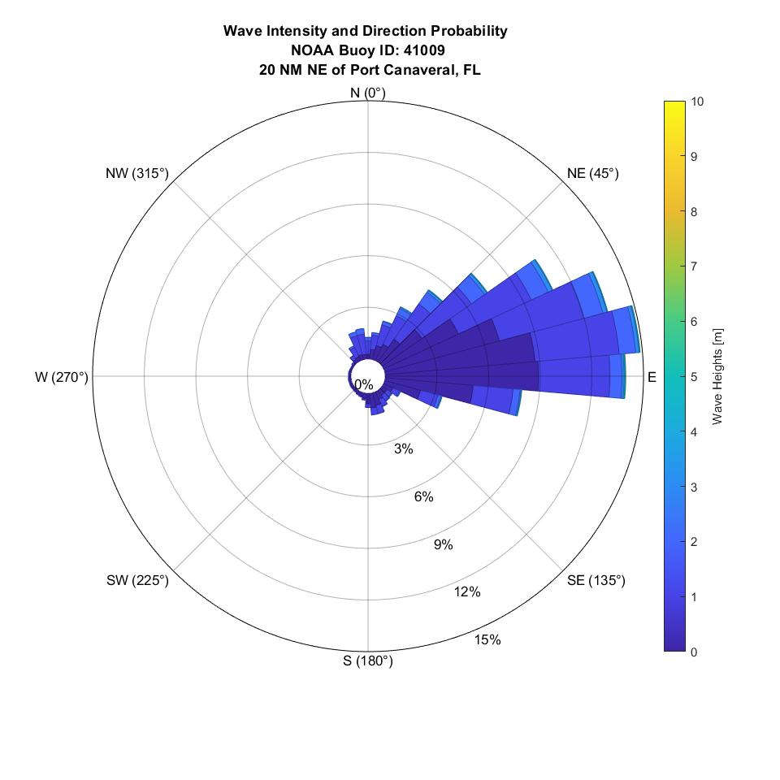
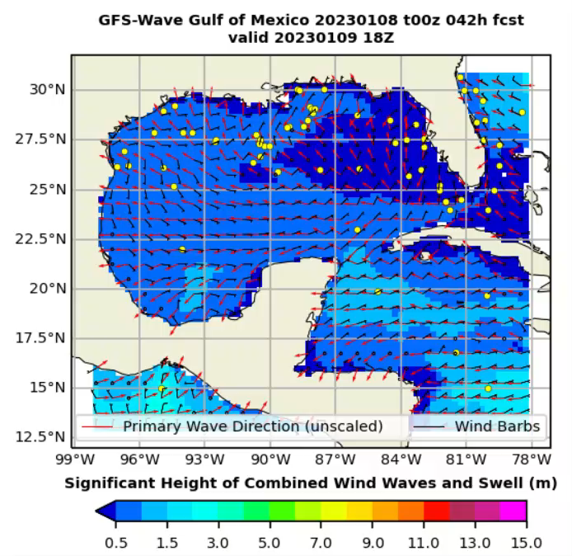
Types and Classes of Variables
The set of all possible values is the population
Engineers must identify and define the population

Slide 6

Let’s Discuss Your Homework
Class Activity
This Photo by Unknown Author is licensed under CC BY-SA
Notes:
How did the homeworks go?
Anyone care to share their lists?

Slide 7

Let’s Break Down a Wave
Class Activity

Slide 8











Let’s Break Down a Wave
$$T$$
$$L$$
Crest
$$z=h+η(x,t)$$
$$a$$
$$z=0$$
$$H$$
$$η(x,t)$$
$$a$$
$$h$$
Trough
$$z=−h$$

Slide 9
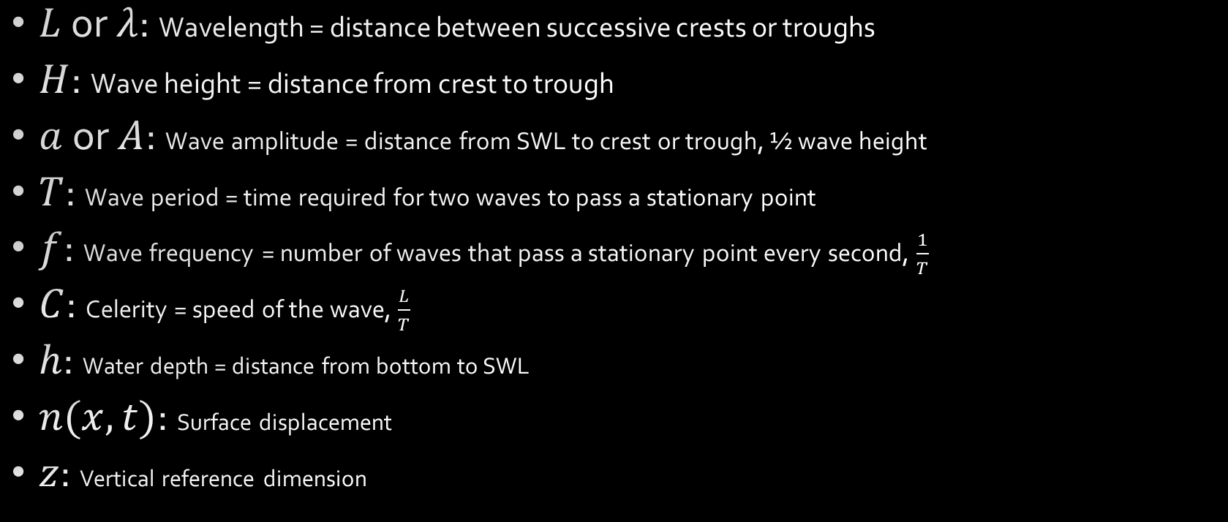
Wave Variables
$L$ or $λ$: Wavelength = distance between successive crests or troughs
$H$: Wave height = distance from crest to trough
$a$ or $A$: Wave amplitude = distance from SWL to crest or trough, ½ wave height
$T$: Wave period = time required for two waves to pass a stationary point
$f$: Wave frequency = number of waves that pass a stationary point every second, $\frac{1}{T}$
$C$: Celerity = speed of the wave, $\frac{L}{T}$
$h$: Water depth = distance from bottom to SWL
$n(x,t)$: Surface displacement
$z$: Vertical reference dimension

Slide 10
Surfer Variables
Roll, $φ$
Roll rate, $\frac{dφ}{dt}=\dot{φ}$
Roll, 𝜙
Roll rate, 𝑑𝜙/𝑑𝑡=𝜙 ̇
Pitch, $θ$
Pitch rate, $\frac{dθ}{dt}=\dot{θ}$
Pitch, 𝜃
Pitch rate, 𝑑𝜃/𝑑𝑡=𝜃 ̇
Yaw, $ψ$
Yaw rate, $\frac{dψ}{dt}=\dot{ψ}$
Yaw, 𝜓
Yaw rate, 𝑑𝜓/𝑑𝑡=𝜓 ̇

Slide 11


Surfer Variables
Surge, $a_{x}$ Forward Velocity, ${\dot{a}}_{x}=\frac{da_{x}}{dt}=v_{x}$, Forward Displacement, $\ddot{a_{x}}=\frac{d{\dot{a}}_{x}}{dt}=s_{x}$
Sway, $a_{y}$ Side Velocity, ${\dot{a}}_{y}=\frac{da_{y}}{dt}=v_{y}$, Side Displacement, $\ddot{a_{y}}=\frac{d{\dot{a}}_{y}}{dt}=s_{y}$
Heave, $a_{z}$ Vertical Velocity, ${\dot{a}}_{z}=\frac{da_{z}}{dt}=v_{z}$, Vertical Displacement, $\ddot{a_{z}}=\frac{d{\dot{a}}_{z}}{dt}=s_{z}$
Y
X
Z

Slide 12
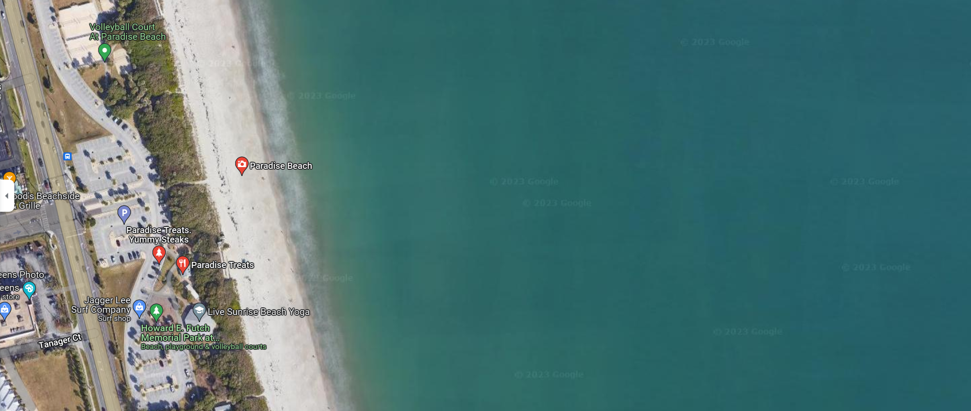
Surfer Variables
N
D
E
Longitude
Latitude
Course
Speed
Elevation
Northing Displacement
Easting Displacement

Slide 13

Research Topic Quad Chart
Wednesday January 18

Slide 14

Dice Roll Programming Assignment
Friday, January 20

Slide 15

Questions?

Slide 16


Histograms and Frequency Distributions
A population has:
A true mean, $μ_{x}$
A true variance, $σ_{x}^{2}$
If we take a sample of the population:
The sample mean is $\overline{X}=\frac{1}{N}\sum_{i=1}^{N}{x_{i}}$
The sample variance is $S^{2}=\frac{1}{N−1}\sum_{i=1}^{N}{{\left(x_{i}−\overline{X}\right)}^{2}}$
As the number of samples, $N$, approaches the population size then:
$$\overline{X}→μ_{x}$$
$$S^{2}→σ_{x}^{2}$$

Slide 17
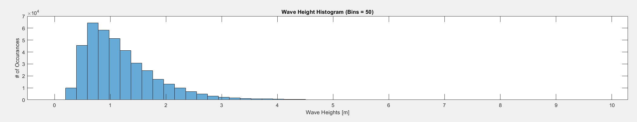
Histograms and Frequency Distributions
We can use a histogram to describe a population
Histograms are a bar plot of how many times a particular sample falls into a specific range

